Slide 1


Visualizing Climate Change in Pakistan
By: Ali Mashood

Slide 2

Objective
The aim of the project is to create effective data visualization for analysis.
This includes information on different factors that create an impact on climate change trends in Pakistan.
Provide clear and insightful visualizations to educate users about the current state and trends of climate change in Pakistan.
Allow users to interact with the data to explore specific regions, time periods, and climate variables.
Encourage users to understand the urgency of climate change and the need for immediate action through compelling visual narratives.
This Photo by Unknown Author is licensed under CC BY-NC

Slide 3

Introduction
Understanding the climate change indicators is crucial for a country like Pakistan which is significantly impacted by climate change.
This dataset provides a brief overview of different factors that impact the change in climate of Pakistan.
The dataset covers an extensive period providing an in-depth analysis of climate change over the years in Pakistan.
It also highlights how different factors affect the economy and environment of Pakistan influencing different aspects of economies such as agriculture, urban-development and health.
The goal of this analysis is to highlight and view different trends, patterns and understand their implications on the policy and planning to address climate change in Pakistan.

Slide 4
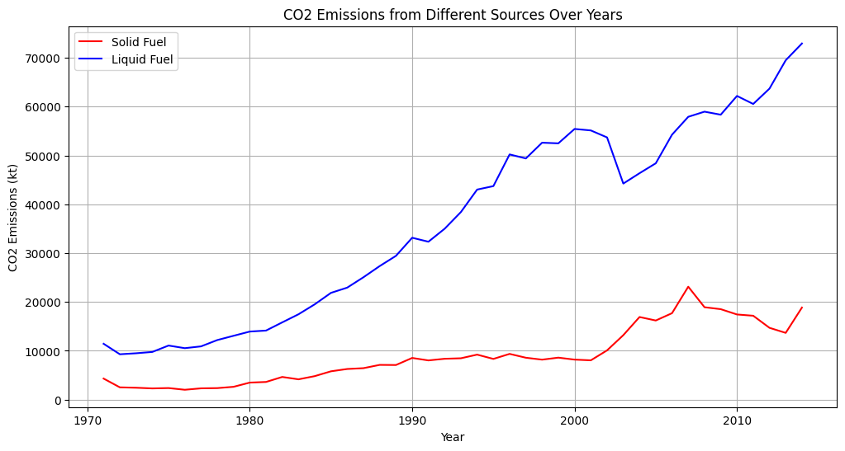
CO2 Emissions from Different Sources Over Years.
The graph shows that the CO2 emissions from different sources have increased.
The solid fuel has increased but between 1990 and 2000 there is a slight decrease however more or less there is increase in Solid fuel.
Liquid fuel has also an increase with a slight decrease between 2000 and 2010 but overall increase.
Comparatively liquid fuel increase is much more than solid fuel over the past few years.

Slide 5
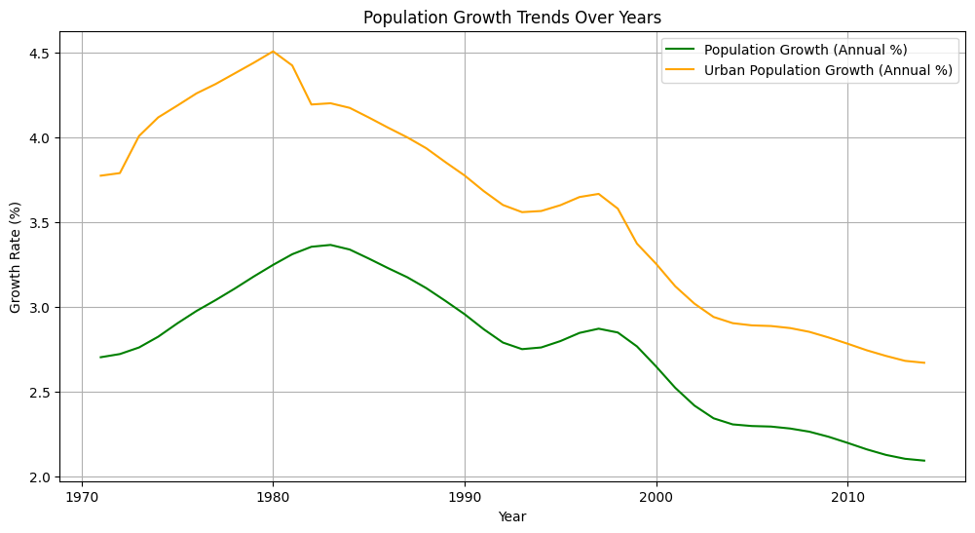
Population Growth Over Years
Population growth peaked in the 1980s and declined steadily since.
Urban population growth consistently outpaced overall population growth.
Significant urbanization trend observed despite declining growth rates.
Declining growth rates indicate a need for targeted urban planning.

Slide 6
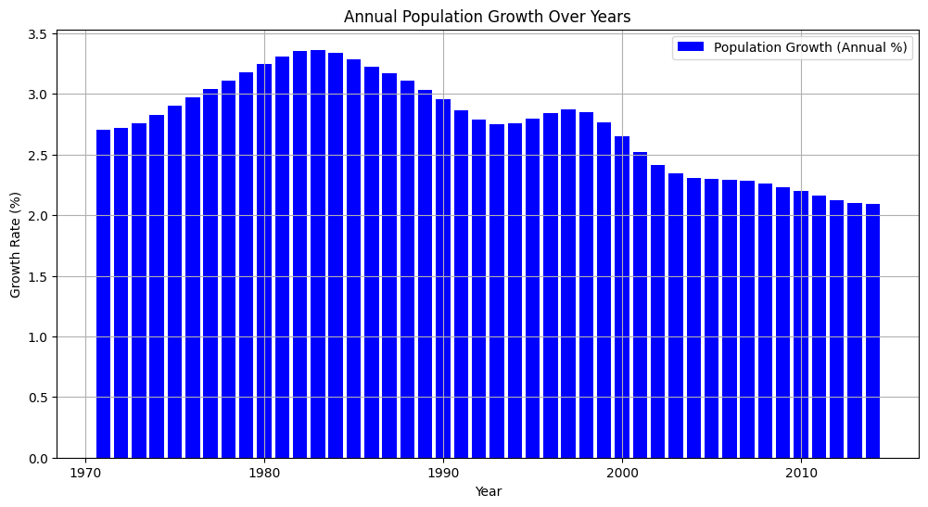
Annual Population Growth over Years
It is evident that the population growth was highest during 1980s.
There is a slight increase in trend from 1970s till 1980s.
Afterwards there is a slight decrease in population from 1980s till 1990s.
In 2000s there is a steady decline in population annually.

Slide 7
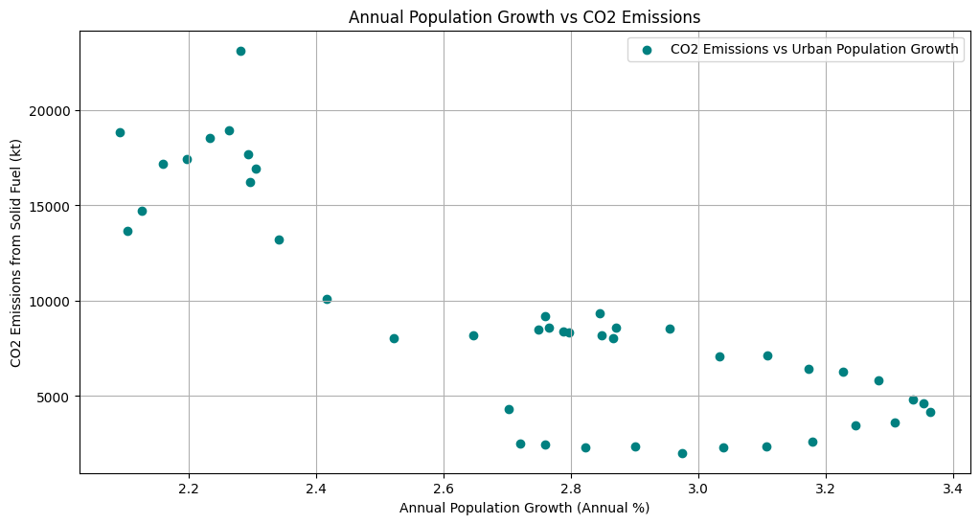
Annual Population Growth vs CO2 Emissions
Negative Correlation Observed: There is a noticeable negative correlation between annual population growth and CO2 emissions from solid fuel consumption.
High Emissions at Lower Growth Rates: Higher CO2 emissions are clustered around lower population growth rates (2.2% to 2.6%).
Declining Emissions with Increased Growth: As annual population growth rates increase beyond 2.6%, CO2 emissions from solid fuels tend to decrease.
Implications for Policy: This trend suggests that managing population growth could be a key factor in controlling CO2 emissions.

Slide 8
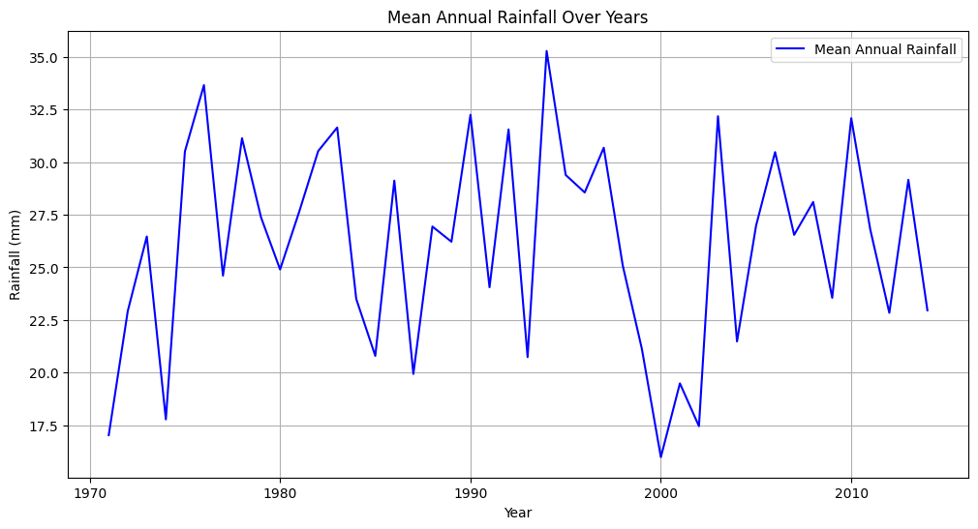
Mean Annual Rainfall over Years
Fluctuating Rainfall: The mean annual rainfall in Pakistan has shown significant fluctuations from 1970 to 2013.
Peaks and Troughs: Notable peaks in rainfall occurred in the late 1970s, early 1980s, and late 1990s, while significant drops were observed in the late 1980s and early 2000s.
Long-term Trend: Despite the variability, no clear increasing or decreasing trend in mean annual rainfall is evident over the entire period.
Implications for Agriculture: These fluctuations highlight the challenges in agricultural planning and water resource management due to the unpredictable nature of annual rainfall.

Slide 9
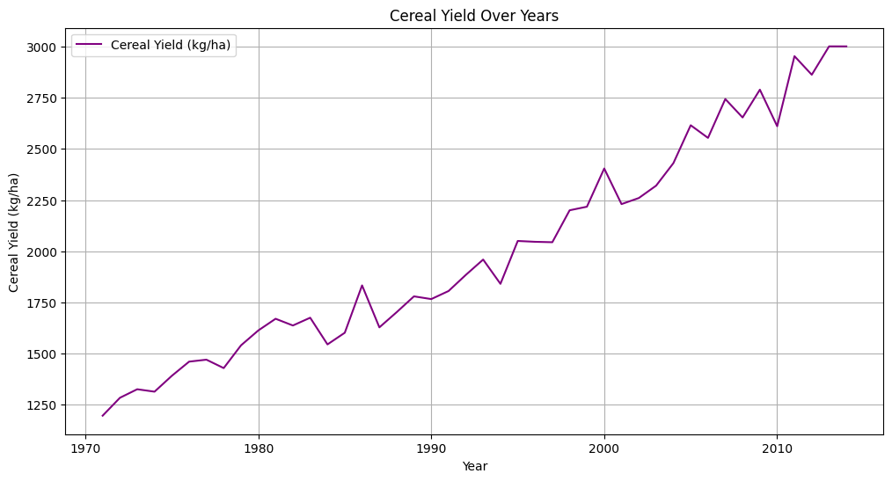
Ceral Yield over Years.
Overall Increase: The graph shows a consistent increase in cereal yield (kg/ha) from 1970 to 2015. This indicates a general improvement in agricultural productivity over the years.
Significant Milestones: Around the mid-1990s and early 2000s, there are noticeable increases in yield, suggesting periods of significant agricultural advancements or improvements.
Fluctuations: Despite the overall upward trend, there are several periods of fluctuation where the yield either plateaued or experienced minor drops, reflecting the variability in agricultural outcomes due to factors like weather, technology, or policy changes.
Peak Yield: By the end of the graph in 2015, the cereal yield reaches approximately 3000 kg/ha, which is the highest point recorded in the given timeframe, marking a substantial increase from the starting yield of around 1250 kg/ha in 1970.

Slide 10
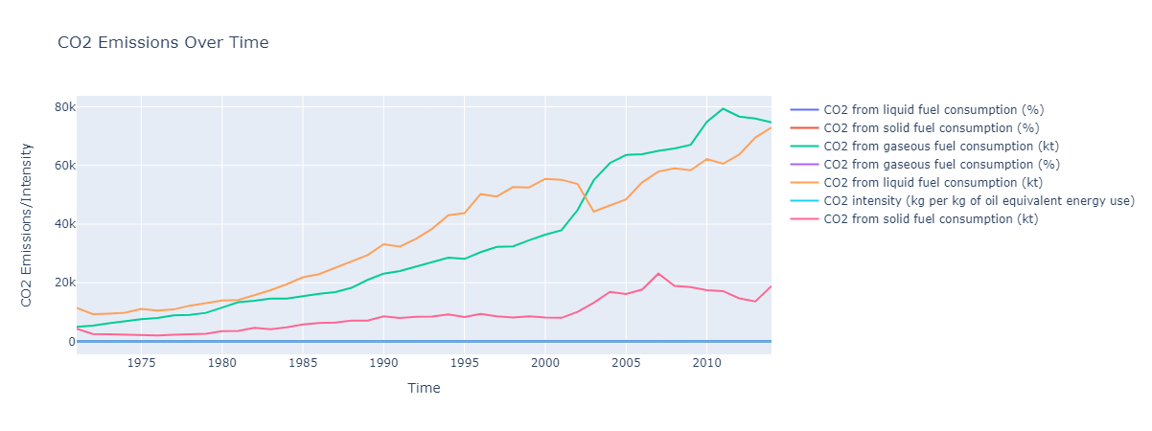
CO2 Emissions Over Time

Slide 11
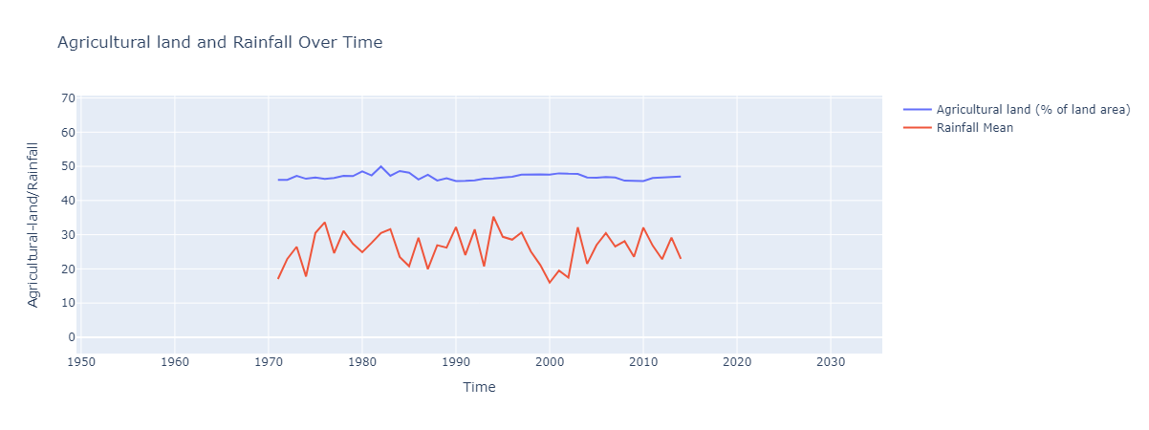
Agricultural Land & Rainfall Over Time
The graph displays the trends in agricultural land percentage and rainfall mean from 1950 to 2020.
Agricultural land shows a relatively stable trend, with slight fluctuations around 50-55% of total land area.
Rainfall mean exhibits significant variability, with notable peaks and troughs over the same period.
The data suggests no direct correlation between the percentage of agricultural land and rainfall mean over time.

Slide 12
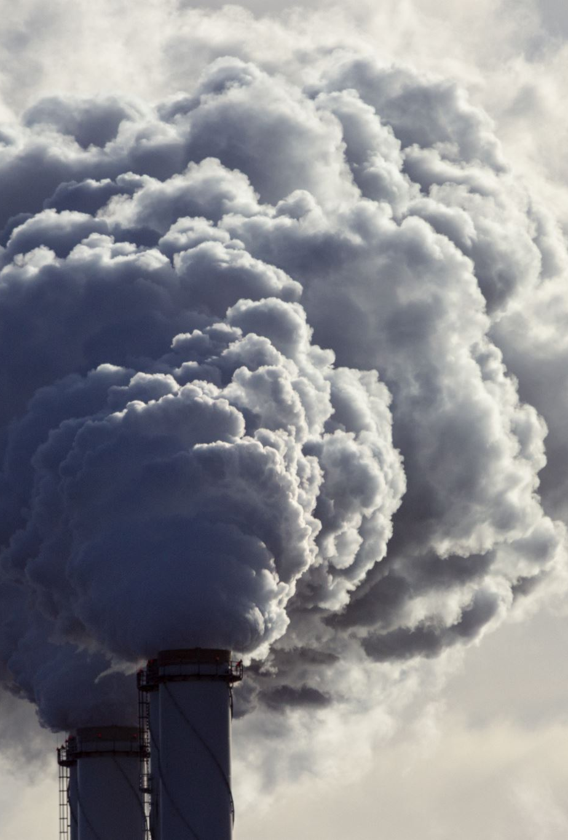
Conclusion
CO2 Emissions Increase: CO2 emissions from various sources, particularly solid and liquid fuels, have generally increased over the years. There is a notable rise in liquid fuel emissions compared to solid fuels​.
Population Dynamics: Population growth peaked in the 1980s and has declined since. Urban population growth has consistently outpaced overall population growth, indicating significant urbanization despite declining growth rates.
Rainfall Variability: Mean annual rainfall in Pakistan has shown significant fluctuations from 1970 to 2013, with no clear increasing or decreasing trend. These fluctuations pose challenges for agricultural planning and water resource management.
Cereal Yield Improvement: There has been a consistent increase in cereal yield from 1970 to 2015, indicating improvements in agricultural productivity. Significant milestones in the mid-1990s and early 2000s suggest periods of notable agricultural advancements​.
Agricultural Land and Rainfall Correlation: The percentage of agricultural land has remained relatively stable with slight fluctuations, while rainfall mean exhibits notable variability. This suggests no direct correlation between agricultural land percentage and rainfall mean over time​

